Slide 1
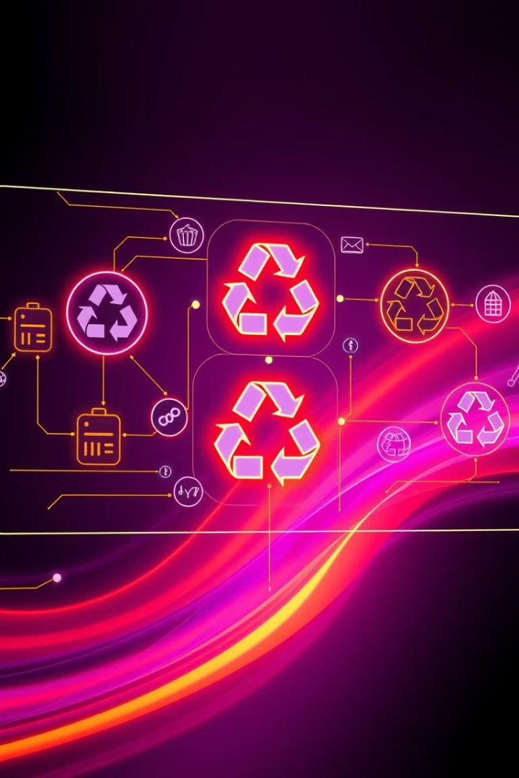
E-Waste Tracker System: Project Report
This report details the development and implementation of the E-Waste Tracker System, a critical digital platform designed to streamline electronic waste (e-waste) management. Our objective is to ensure compliance with environmental regulations while actively promoting a robust circular economy. This system aims to create a transparent and efficient ecosystem for all stakeholders involved in the e-waste lifecycle, from collection to recycling.

Slide 2



Addressing the Global E-Waste Challenge
Escalating Global E-Waste
Informal Recycling Risks
Regulatory Transparency Gaps
In India, e-waste generation is growing at an alarming rate. A significant challenge lies in prevalent informal recycling practices, which often involve hazardous procedures. These methods expose workers and surrounding communities to toxic substances, leading to severe health complications and widespread environmental contamination.
In 2022, the world generated approximately 62 million tonnes of e-waste, with a mere 22.3% being properly recycled. Projections indicate this volume will surge to 82 million tonnes by 2030, highlighting an urgent global crisis. This relentless increase in e-waste poses severe threats to environmental health and resource sustainability.
Current e-waste management systems frequently lack critical features such as real-time tracking, comprehensive transparency, and robust accountability mechanisms. These deficiencies make it difficult to monitor compliance effectively, leading to inefficiencies and potential circumvention of environmental regulations. Our system aims to bridge these gaps.

Slide 3
System Architecture and Technology Stack
Multi-Tier Architecture
Key Technologies Used
The E-Waste Tracker System employs a robust multi-tier architecture to ensure scalability, maintainability, and efficient data processing. This design separates functionalities into distinct layers, allowing for independent development and deployment of components. This structured approach enhances system stability and facilitates future enhancements without impacting the entire platform.
Our selection of technologies is based on industry best practices, focusing on performance, scalability, and developer efficiency. This stack provides a solid foundation for the complex demands of real-time e-waste tracking and data management.
Frontend: ReactJS for dynamic interfaces, complemented by HTML5 and CSS3 for rich user experiences.
Backend: Node.js and Express.js provide a high-performance, scalable server-side environment.
Frontend: Provides intuitive user interfaces for consumers and administrators, built for seamless interaction.
Database: MongoDB ensures flexible and scalable data storage for diverse e-waste data.
Backend: Manages core business logic and secure data storage through APIs and robust database management.
APIs: RESTful services enable seamless and efficient communication between all system components.
Integration Layer: Facilitates secure communication and data exchange with crucial third-party services, including payment gateways and notification systems, ensuring a comprehensive operational flow.

Slide 4
Core Features for E-Waste Management
User Registration & Authentication
E-Waste Pickup Request
Ensures secure access with role-based controls, protecting sensitive user data and maintaining system integrity. Each user, whether a consumer or an administrator, receives specific permissions tailored to their role.
Consumers can easily schedule pickups for their electronic waste items through a user-friendly interface. This feature streamlines the initial collection process, making it convenient for users to responsibly dispose of their e-waste.
Agent Assignment
Tracking & Notifications
Administrators can efficiently assign collection agents to scheduled e-waste pickups. This ensures optimal route planning and timely collection, improving operational efficiency and reducing logistical delays.
Provides real-time updates on pickup status through SMS and email notifications. This transparency keeps consumers informed and ensures accountability throughout the collection process, from scheduling to successful pickup.

Slide 5





E-Waste System Workflow: A Seamless Process
Consumer Interaction
Consumers initiate the process by registering on the platform and submitting a request for e-waste pickup. This user-friendly step captures all necessary details, including item type and preferred collection time, ensuring a smooth start to the process.
Admin Oversight
Administrators review pickup requests, efficiently assigning them to available collection agents based on location and schedule. They monitor the overall pickup schedule, ensuring timely assignments and effective resource allocation.
Agent Execution
Assigned agents collect the e-waste from designated locations. They are responsible for updating the pickup status in real-time, providing transparency and tracking capabilities for both consumers and administrators.
Recycling Processing
Once collected, e-waste is transferred to integrated recycling centers. The centers update the processing status, documenting each step of recycling, ensuring full transparency and compliance with environmental standards.
Reporting for Compliance
The system generates comprehensive reports on e-waste statistics and compliance, providing valuable insights for regulatory bodies and stakeholders. These reports facilitate data-driven decision-making and continuous improvement.

Slide 6
Overcoming Implementation Challenges
Challenge: Real-time Tracking
1
Ensuring immediate and accurate updates on e-waste pickup and processing status presented a significant technical hurdle. Traditional polling methods would have been inefficient and resource-intensive.
2
Solution: WebSocket Integration
We implemented WebSocket technology to enable persistent, full-duplex communication channels between the server and clients. This allows for instantaneous updates, providing real-time tracking capabilities and enhancing user experience.
Challenge: Data Volume Management
3
Handling the continuously growing volume of e-waste data, including user requests, tracking information, and recycling records, required a robust and scalable database solution. Relational databases posed potential bottlenecks.
4
Solution: MongoDB's Scalability
Leveraging MongoDB, a NoSQL database, allowed us to manage large volumes of unstructured and semi-structured data efficiently. Its flexible schema and horizontal scalability features ensured high performance and data integrity.
Challenge: User Adoption
5
Encouraging widespread adoption and sustained engagement from diverse user groups was crucial. Users needed a compelling reason to switch from traditional disposal methods to our digital platform.
6
Solution: Intuitive UI & Incentives
We developed an intuitive and user-friendly interface that simplifies the e-waste disposal process. Additionally, a system of participation incentives, such as reward points or discounts, was introduced to boost user engagement.

Slide 7




Impact and Benefits of the System
Environmental Impact
Economic Benefits
Social Awareness
Economically, the system facilitates the recovery of valuable materials from e-waste, turning waste into resources. It also stimulates the creation of green jobs within the formal recycling sector, boosting local economies.
Beyond its operational benefits, the system plays a crucial role in raising public awareness and educating communities on the importance of responsible e-waste management. This fosters a more environmentally conscious society.
The system significantly contributes to environmental sustainability by reducing improper e-waste disposal. It promotes systematic recycling, minimizing harmful landfill waste and preventing soil and water contamination.

Slide 8

Future Enhancements for Growth
Blockchain Integration
Implementing blockchain technology will enhance data integrity and traceability throughout the entire e-waste management lifecycle. This ensures immutable records, boosting transparency and accountability, and preventing fraudulent activities.
Dedicated Mobile Application
Developing a native mobile application will significantly increase accessibility and user engagement. A dedicated app will offer a seamless experience for scheduling pickups, tracking status, and receiving notifications on the go.
AI Analytics for Optimization
Integrating advanced AI analytics will enable predictive analysis for optimizing collection routes and forecasting e-waste generation trends. This will lead to more efficient operations, reduced fuel consumption, and improved overall resource allocation.

